Slide 1
Ch3: Embedded SQL Database & Cloud Storage
Creating a first Cloud Run Application

Slide 2
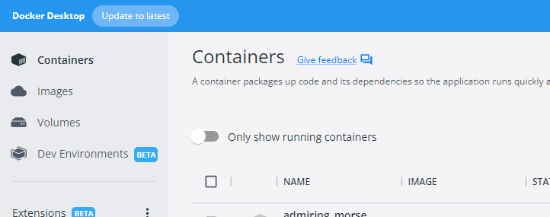
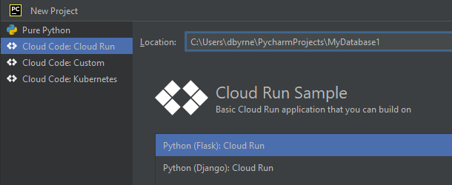
Step 4: Create First Cloud Code App
1->Start Docker
2->Create a new Cloud Code
Project in PyCharm
(as Before)

Slide 3
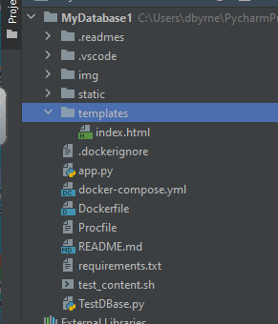
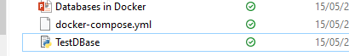
Add 2 Files from Moodle to Project

Slide 4
docker-compose.yml file creates a password protected database in Docker
version: '3'
services:
mysql-development:
image: mysql:8.0.17
environment:
MYSQL_ROOT_PASSWORD: helloworld
MYSQL_DATABASE: testapp
ports:
- "3308:3306"
Mapping External Port/ Local Port

Slide 5
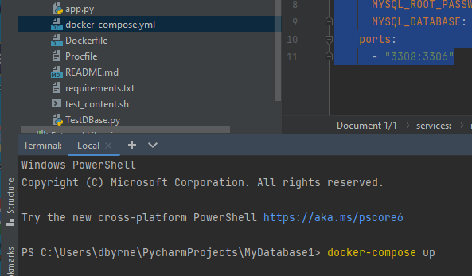
testapp
Open the Terminal and Run docker-compose up to create the Database testapp in Docker

Slide 6

Database Created in Docker

Slide 7
Now we will download MySQL
Establish a connection to the Database in Docker
Create a Table
Add Records

Slide 8
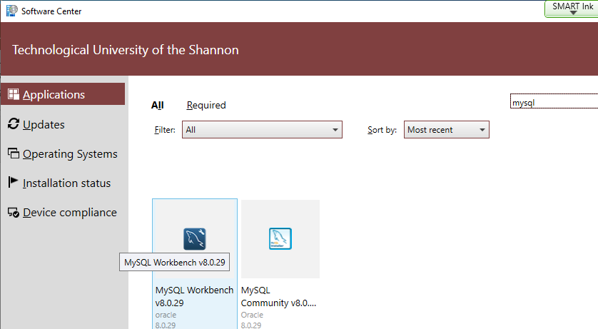
Software Center -> Install -> MySql Workbench

Slide 9
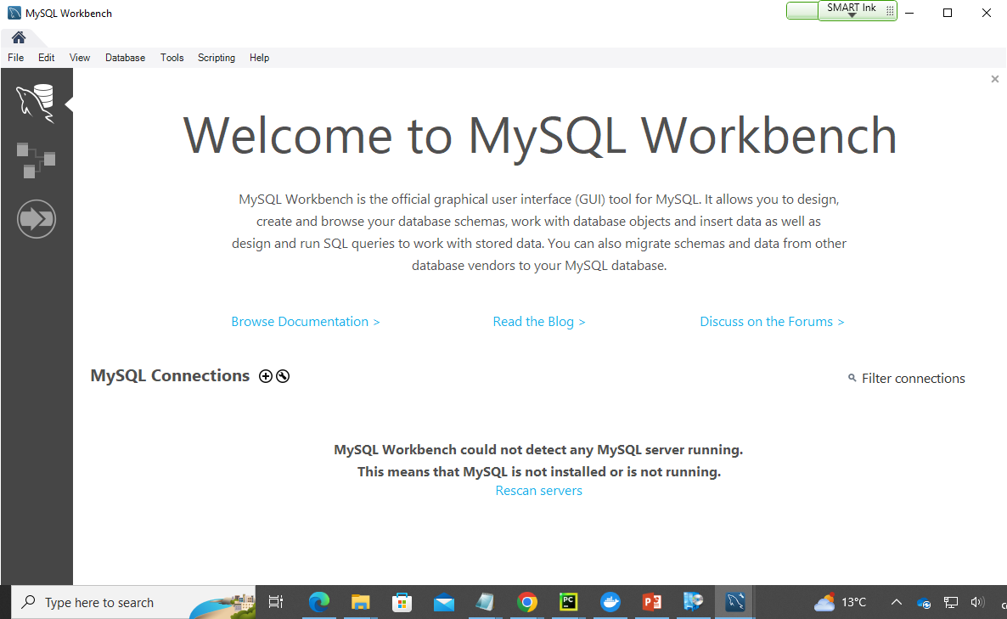

Slide 10
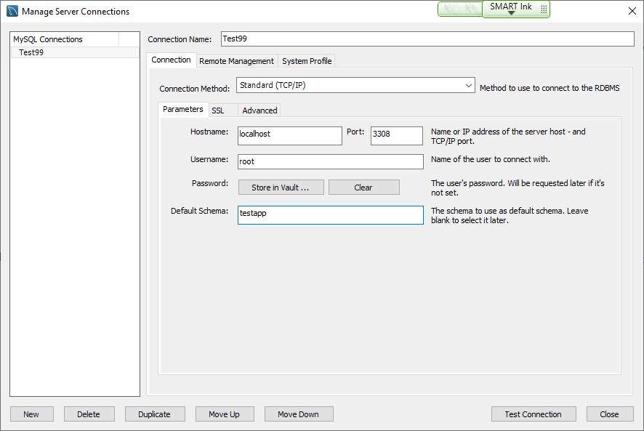
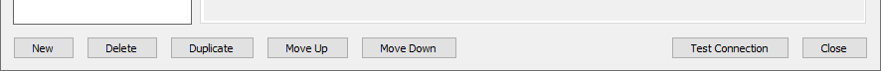

Slide 11
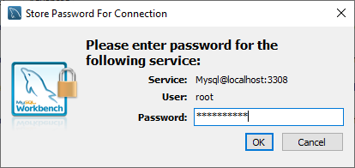
helloworld

Slide 12
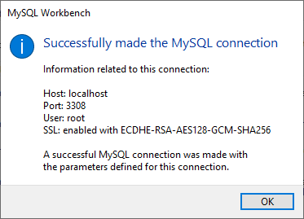

Slide 13
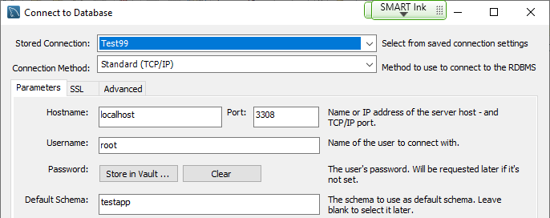
Now we will run SQL Commands in MySQL
Menu -> Database -> Connect to Database

Slide 14
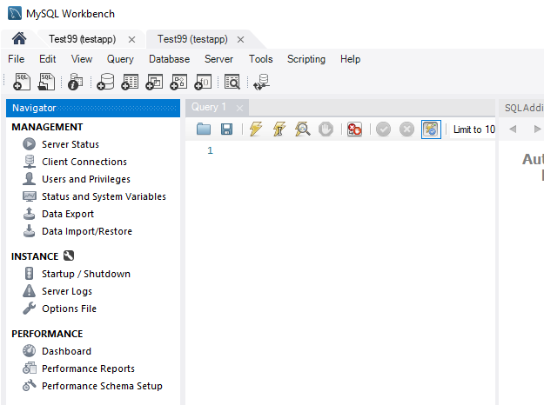

Slide 15
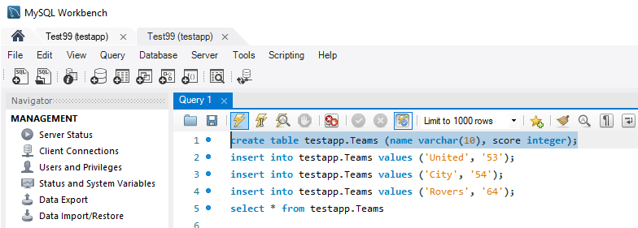
create table testapp.Teams (name varchar(10), score integer);
insert into testapp.Teams values ('United', '53');
insert into testapp.Teams values ('City', '54');
insert into testapp.Teams values ('Rovers', '64');
select * from testapp.Teams
Paste in and Run one at a time By Highlight that query

Slide 16
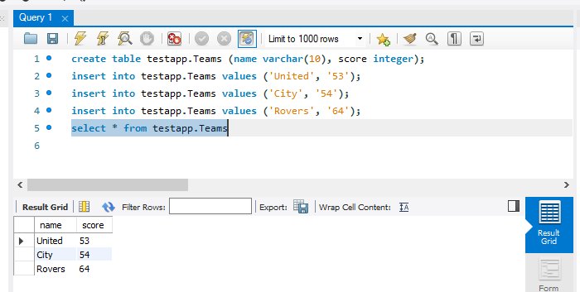

Slide 17
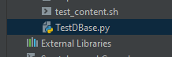
We now go back to PyCharm & create code to Interact TestDataBase.py
with this database running in Docker
-----------------------------------------------------
import pymysql
conn = pymysql.connect(db='testapp', user='root', passwd='helloworld’,
host='localhost',port=3308)
cur = conn.cursor()
cur.execute("select * from testapp.Teams")
allTeams=cur.fetchall()[0][0]
print(allTeams)

Slide 18
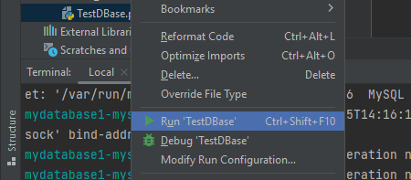

Slide 19
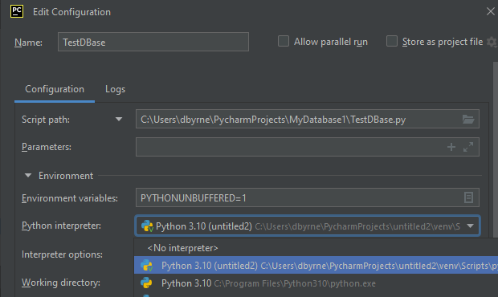
Choose Interpreter

Slide 20
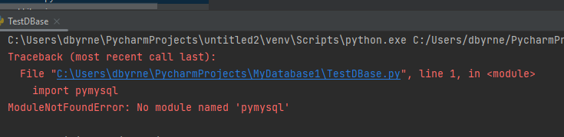
Need to pip install pymysql (If not previously Done)

Slide 21
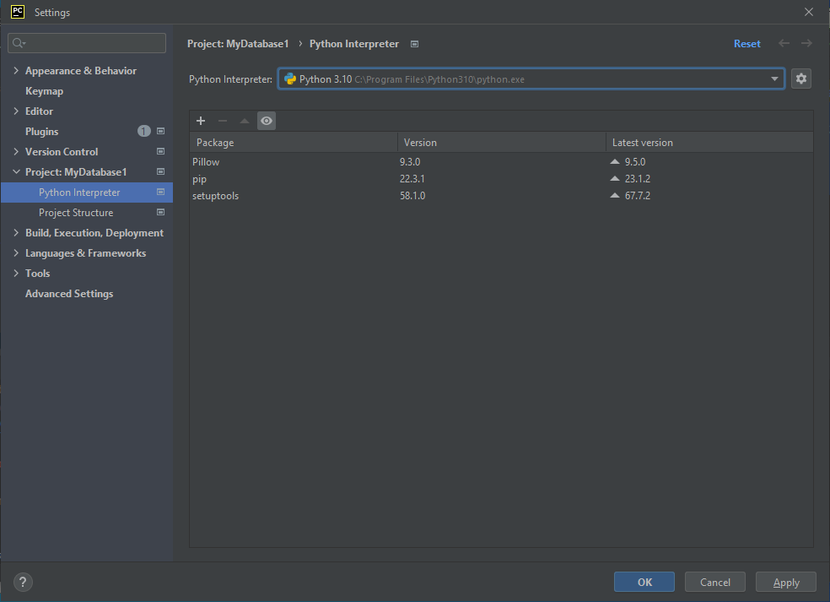
In PyCharm go to File>Settings>Python Interpreter
Choose Python Interpreter
N.B. This must be the same as the
one use in Python Project

Slide 22
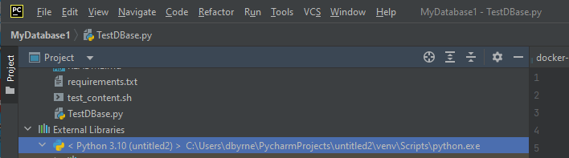
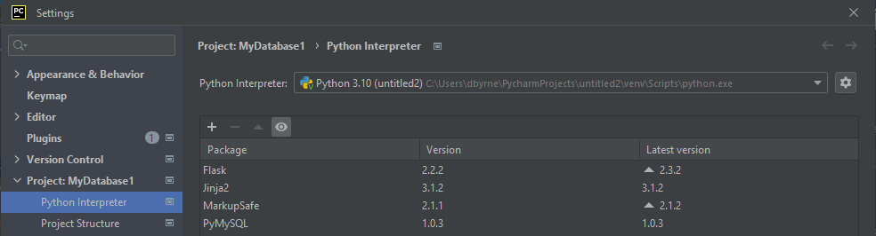
Must be the Same Interpreter

Slide 23
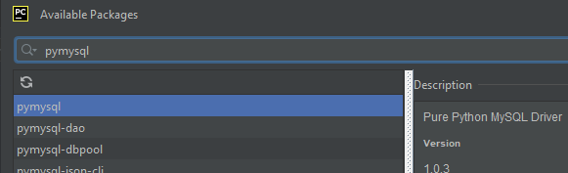
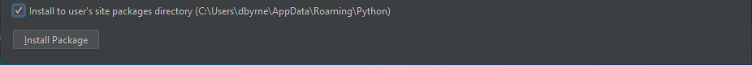
Click on + to add packages & search for pymysql + Click CheckBox at the bottom

Slide 24
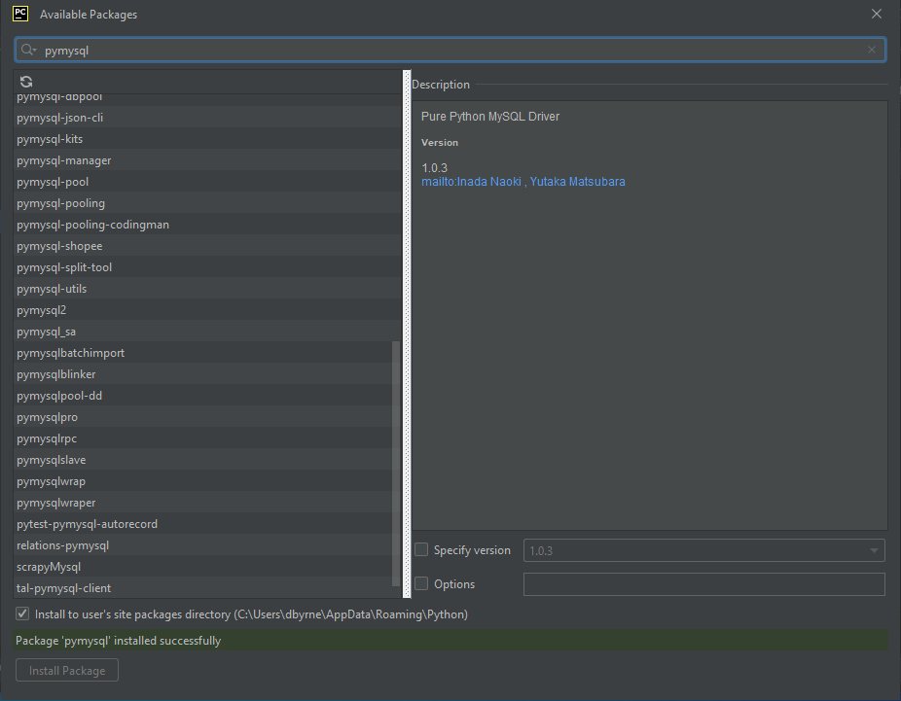

Slide 25
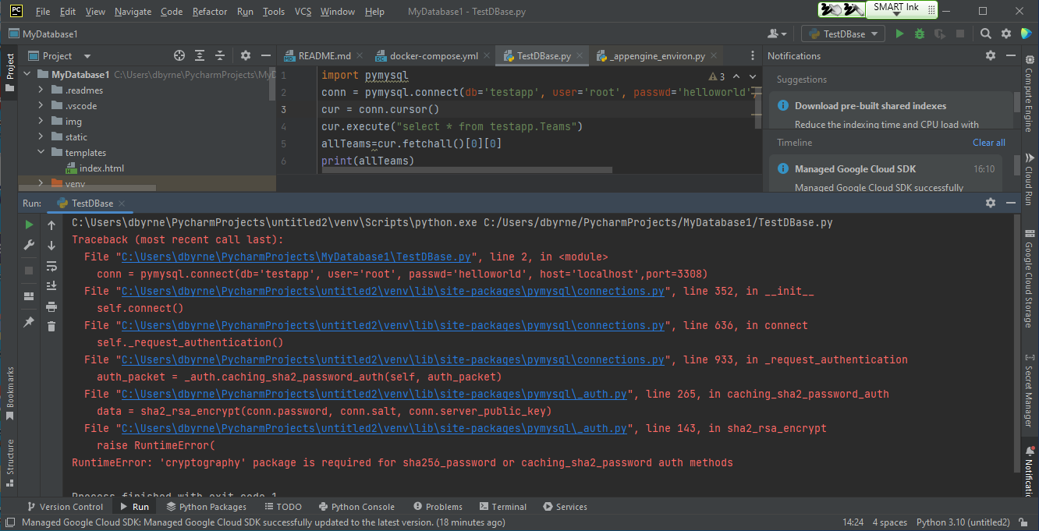
Possible you may be asked to install cryptography also

Slide 26
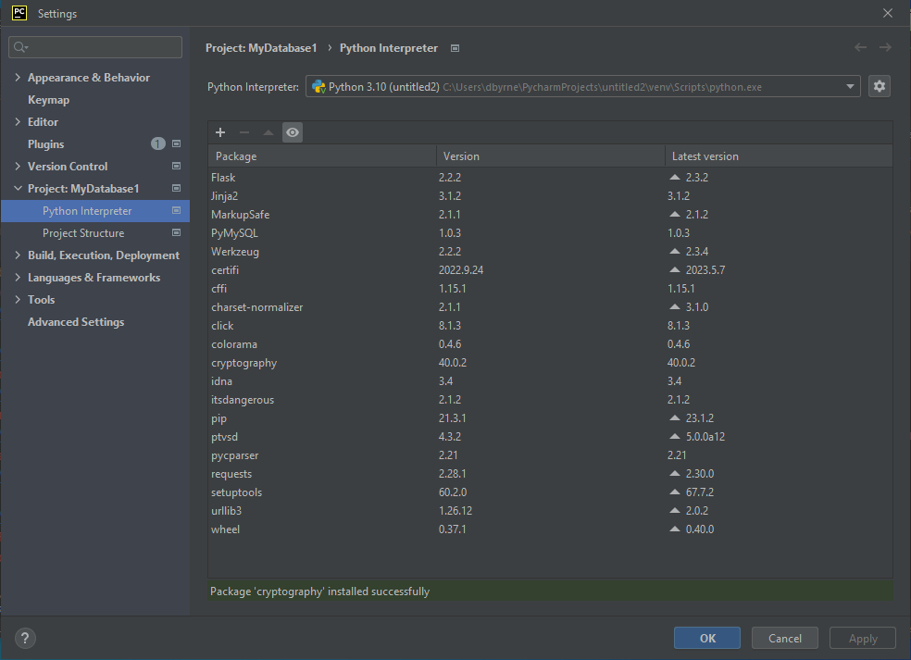
One of the available cryptography packages worked for me

Slide 27
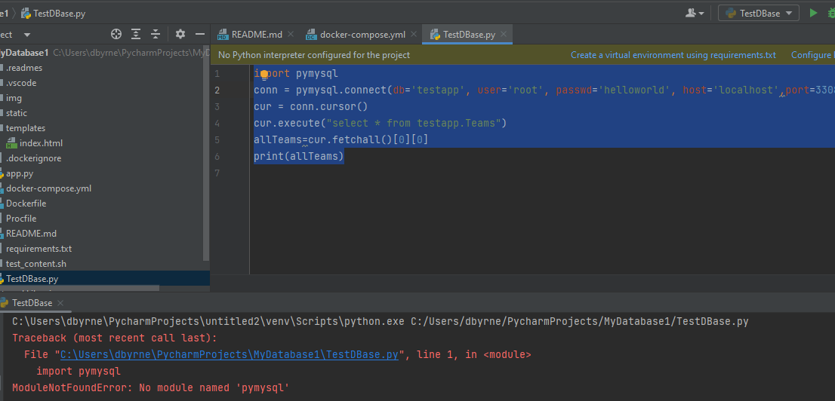
Now we can rerun Application with pymysql installed

Slide 28
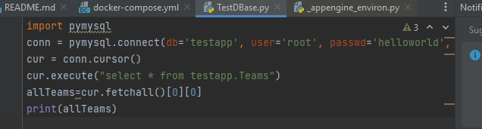


Slide 29
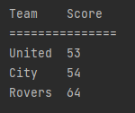
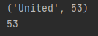
#Q31 TestDBaseQ1.py
#Q31 Modify This File to Give the
following output
import pymysql
conn = pymysql.connect(db='testapp', user='root', passwd='helloworld', host='localhost',port=3308)
cur = conn.cursor()
cur.execute("select * from testapp.Teams")
allTeams=cur.fetchall()[0]
print(allTeams)
print(allTeams[1])
Team Score
===============
United 53
City 54
Rovers 64

Slide 30
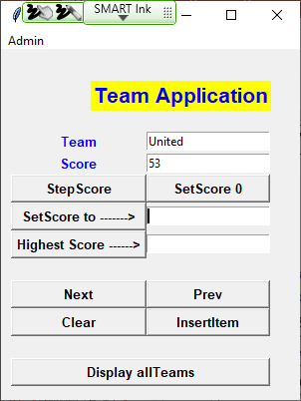
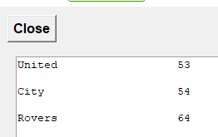
#Q32
We have added GUI From End to DB
Team Score
===============
United 53
City 54
Rovers 64

Slide 31
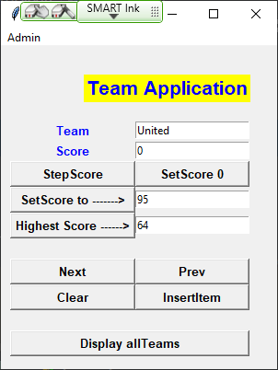
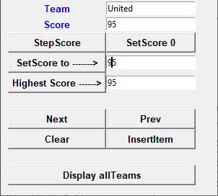
#Q32
Step Score is Working but want to add Fn
Set Score to 0
Set Score to given value
Display Highest Score
N.B. Complete first 3 Methods in Q32_Gui1Q2.py

Slide 32
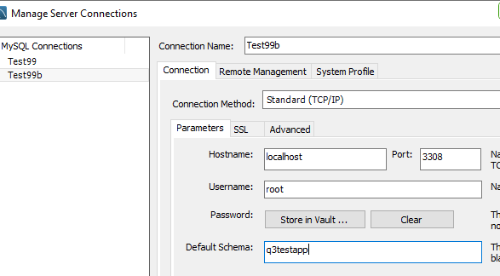
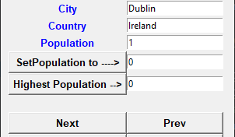
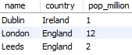
Q3. In this Q you are given the completed Code to Iterate over a Database of Cities, you need to:
Create a new Cloud Code Project MyDataBase3
Start docker
Create a docker-compose.yml to create a new Database q3testapp password: helloworld3
From Terminal docker-compose up
Use SQL Workbench to manage/connect to
MyDataBase3 then create the table bellow
6. Copy in and execute code supplied

Slide 33
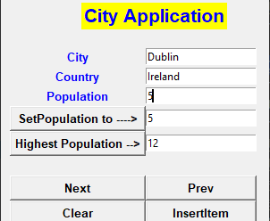
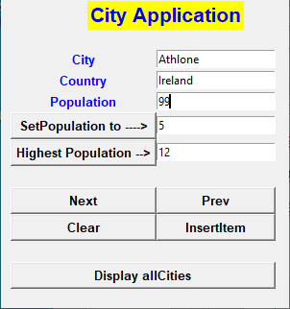
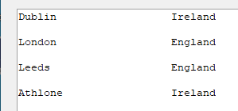
Q4. Complete the Methods
highestPopCmd()
2. updatePopCmd():
3. insertCmd():

Slide 34
Appendix
Problems with Docker
User Group: Ids need to be added to Docker User Group to allow users to use it

Slide 35
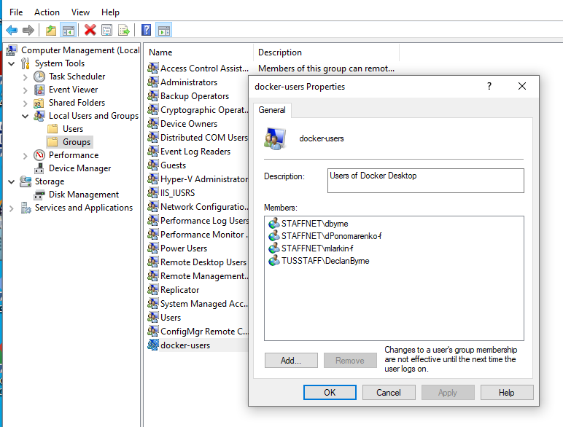
Right Click on
This PC
/Manage/Groups
Need Admin
Privileges to
Add new Users

Slide 36
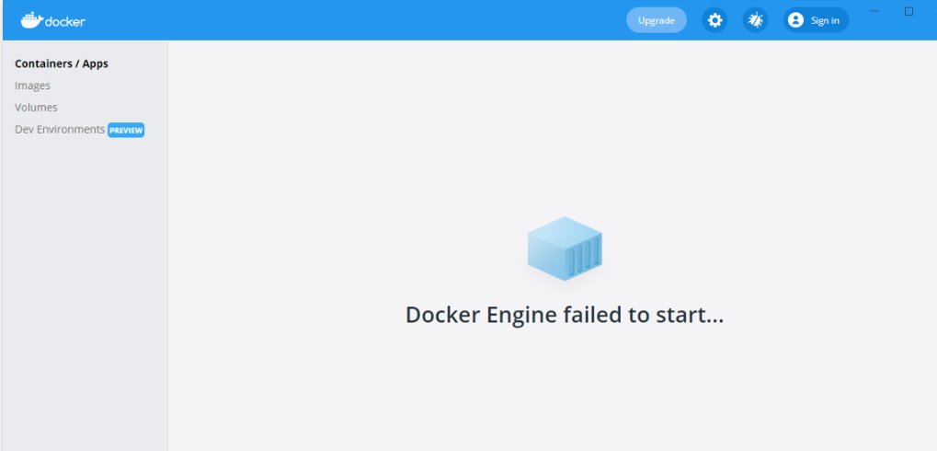

Slide 37
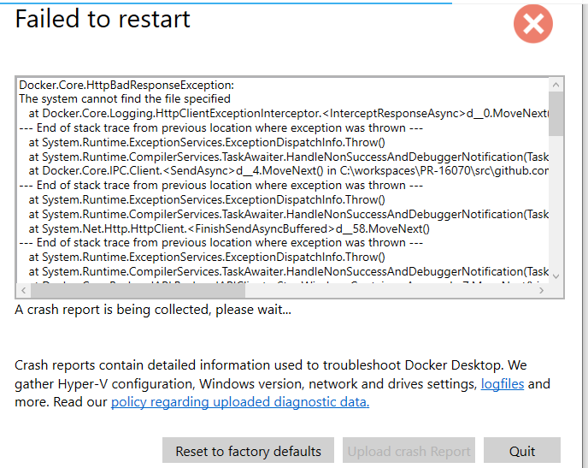
Solution

Slide 38
